Slide 1
LESSON 2 小作文-流程图写作 Flow Chart Writing

Slide 2
目录
1.流程图特点及首段写作
2.流程图词汇及衔接手段
3.流程图（工序圈）范文分析及主体段练习
4.流程图（生长图）范文分析及主体段练习
5.流程图总结段写作
6.课后作业 流程图写作练习

Slide 3
目录
1.流程图特点及首段写作
2.流程图词汇及衔接手段
3.流程图（工序圈）范文分析及主体段练习
4.流程图（生长图）范文分析及主体段练习
5.流程图总结段写作
6.课后作业 流程图写作练习

Slide 4
1.流程图特点 1.1 分类 --- a.工序图

Slide 5
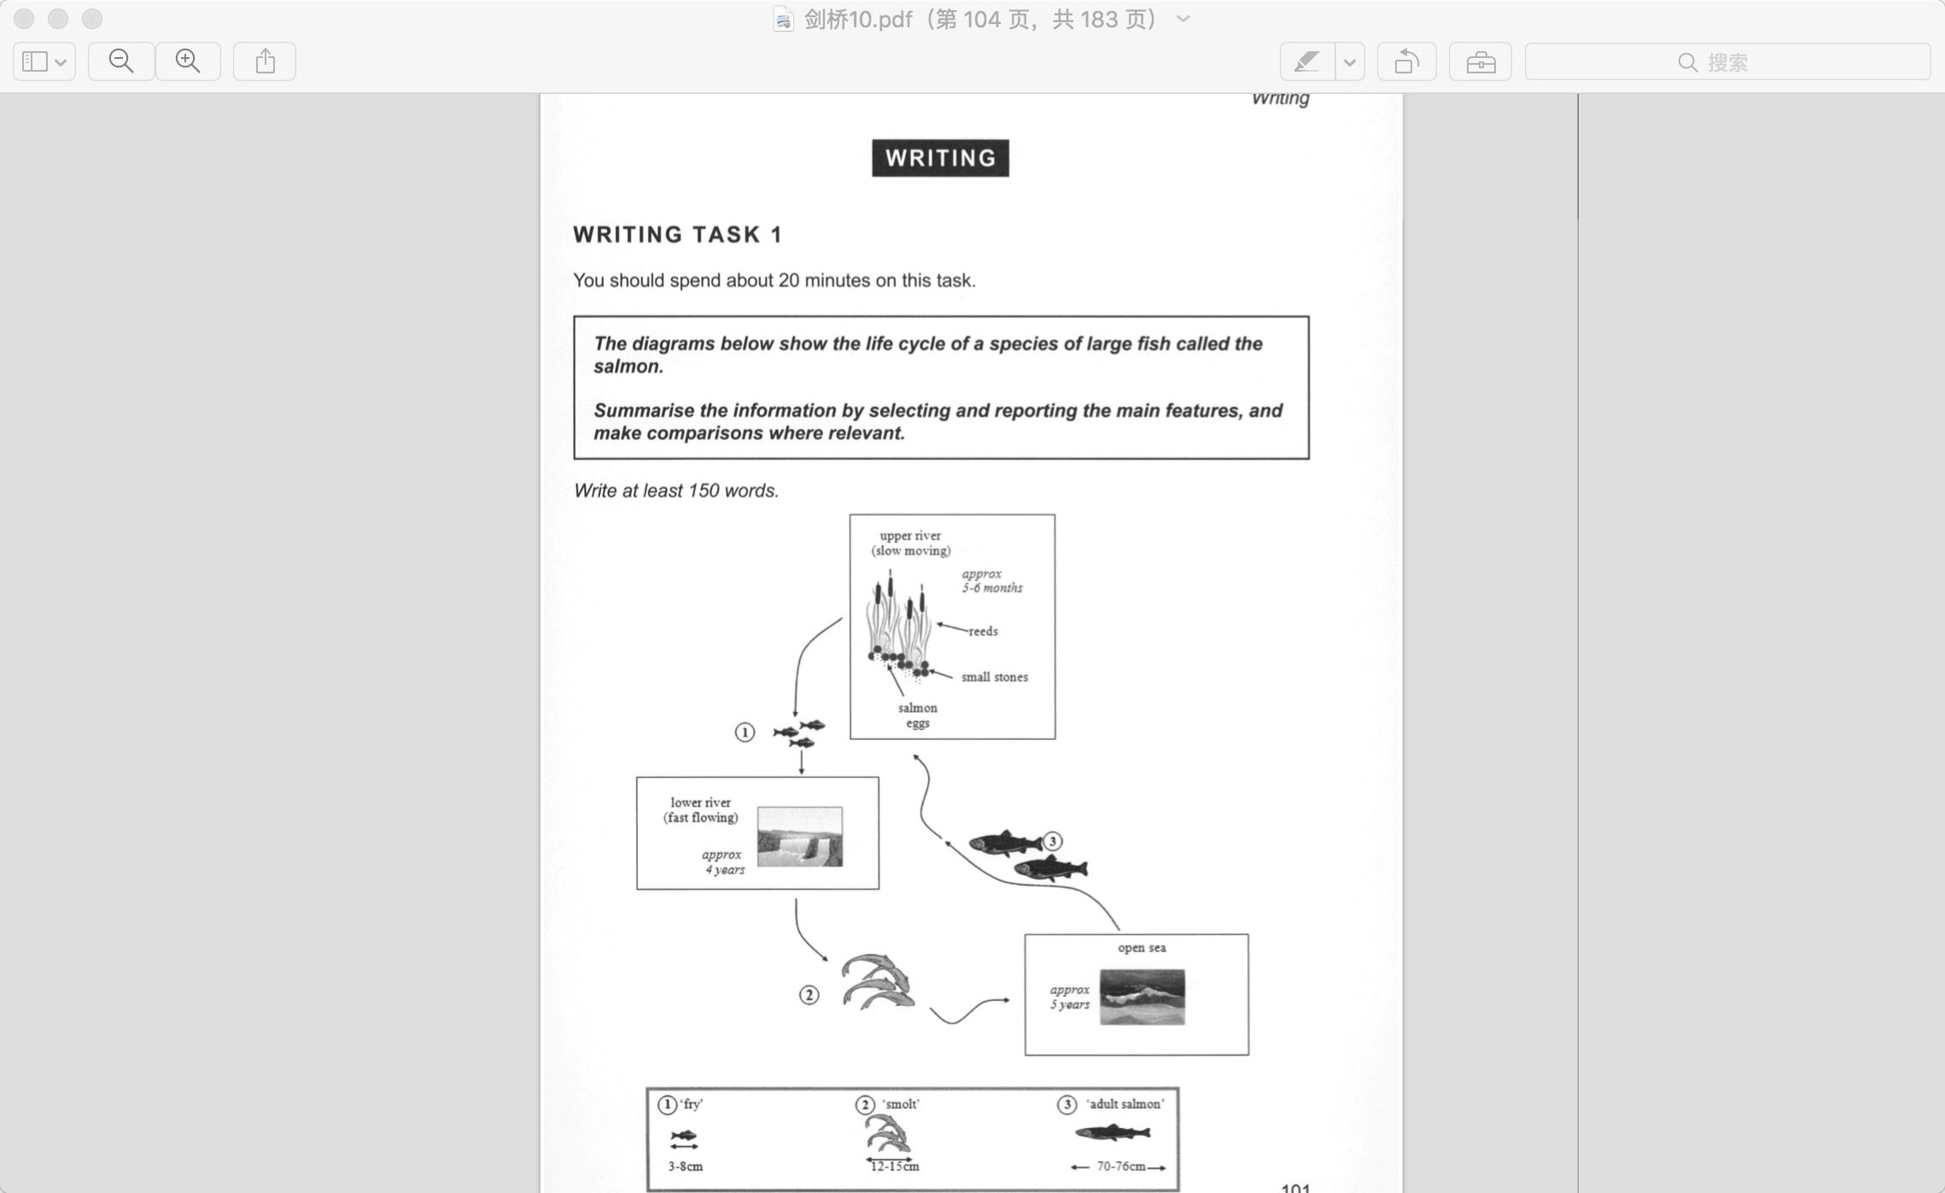
1.流程图特点 1.1 分类 --- b. 生物图

Slide 6
1.流程图特点
1.2 解题要点：
顺序与衔接
分清有几个步骤-箭头数字
找到起点，按顺序进行描述
具体描述每个步骤，步骤过多可以合并写
时态：一般现在时

Slide 7
1.流程图特点
1.3 解题技巧
读图（生词难点）
可根据图片推断词义
名词不懂抄到文中作主语或宾语
动词不懂加ed，用被动语态
梳理（衔接难点）
信息较零散，每一个步骤都要运用不同的动词描述
而由于无主性，使用动词时经常要用动词的被动态

Slide 8
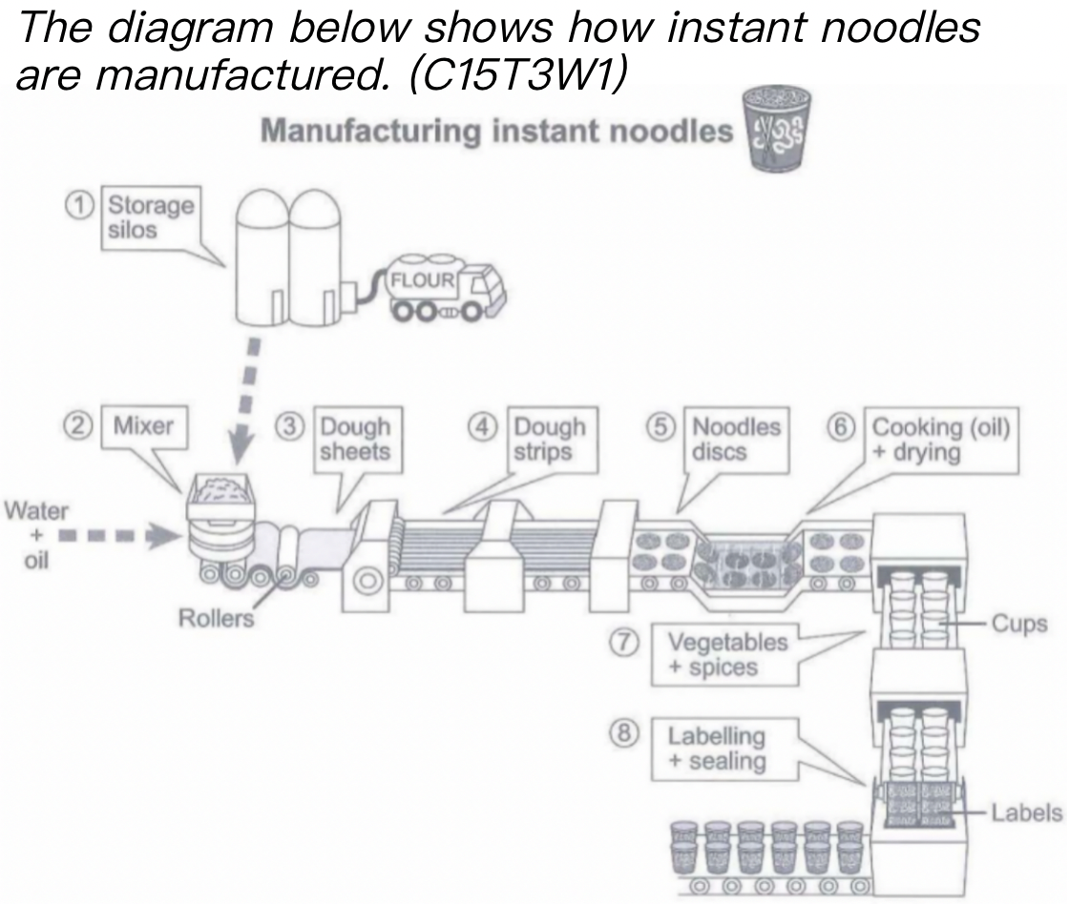
1. 首段写作
换题中宾语(宾语短语和宾语从句互换)（+总步骤数）
(1)产品加工图：
The diagram shows the manufacturing process of instant noodles which includes eight steps from the preparation of raw materials to the completion of final products.
MODEL：
The diagram shows the manufacturing/ making process of ________ which includes ______ steps from the preparation of raw materials to the completion of final products.

Slide 9
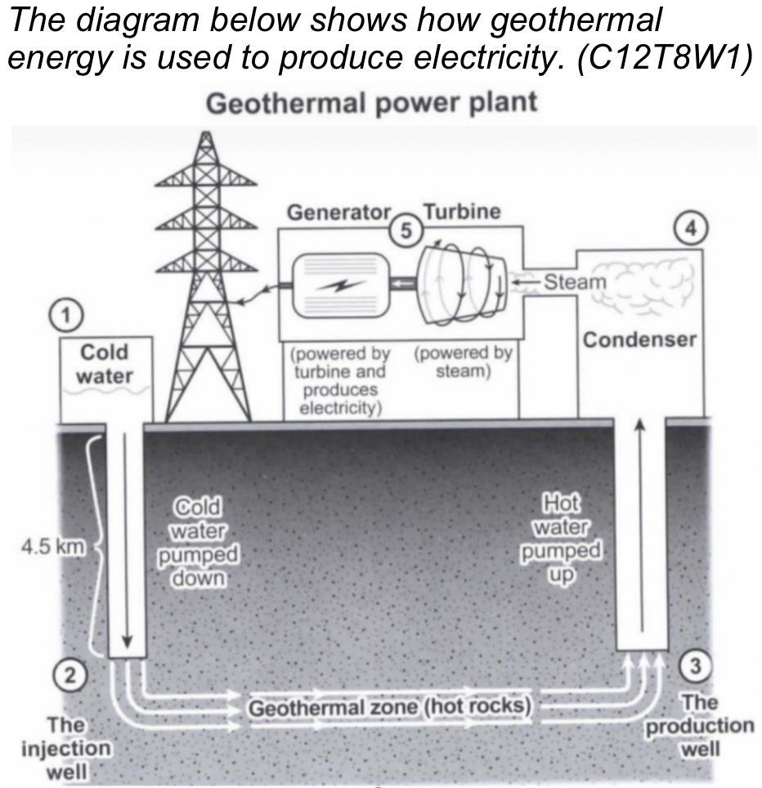
1. 首段写作
换题中宾语(宾语短语和宾语从句互换)（+总步骤数）
(2)能源生产图：
The diagram shows how geothermal power plant works to generate electricity, which includes five steps.
MODEL：
The diagram shows how _____ station/ plant works to produce/ generate _____, which includes ____ steps.

Slide 10
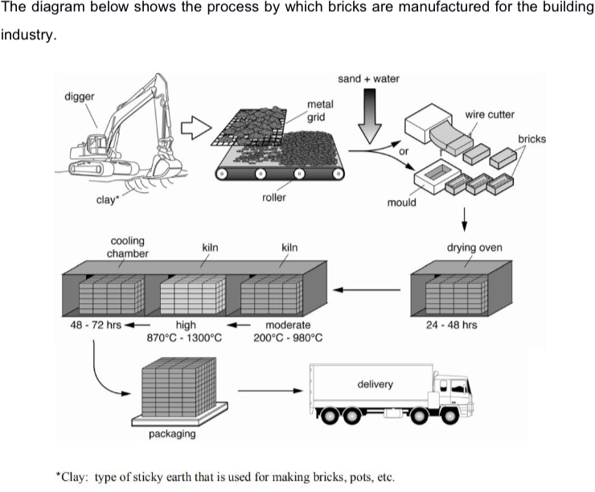
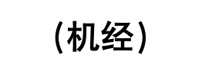
---首段写作PRACTICE
The process shows how _______ are manufactured in _______, which can be outlined in _______ steps.
The process shows how bricks are manufactured in the building industry, which can be outlined in seven consecutive steps.

Slide 11
目录
1.流程图特点及首段写作
2.流程图词汇及衔接手段
3.流程图（工序圈）范文分析及主体段练习
4.流程图（生长图）范文分析及主体段练习
5.流程图总结段写作
6.课后作业 流程图写作练习

Slide 12
2. 词汇与衔接
2.1 材料名词
2.2 高频动词【固/液/气】
2.3 阶段或顺序过渡词

Slide 13
2.1 材料名词
原材料：raw material
半成品：semi-manufactured products
成品：final products, end products

Slide 14
2.2 高频动词
高频动词 – 固体类
放置 lay/place | 挤压 squeeze | 把..加入 add into | 旋转 rotate/spin
混合 mix | 按压 press | 收缩 shrink | 分类 classify
运送 convey | 变成 turn into | 回收 recycle | 晒干 be baked in the sun/dry in the sun
分类 sort/categorize | 折叠/打开 fold/unfold | 累积 accumulate | 缠绕/解开 wind/unwind

Slide 15
2.2 高频动词
高频动词 – 液体类
流入 flow/run into | 蒸发 evaporate | 循环 circulate | 净化 purify
冷却 cool down | 加热 heat/warm up | 沸腾 boil | 泄露 leak
渗透 ooze | 搅拌 stir | 溶解 resolve | 蒸馏 distill
稀释 dilute | 液化 liquefy | 倒入 pour into | 融化 melt

Slide 16
2.2 高频动词
高频动词 – 气体类
燃烧 burn | 膨胀 expand | 压缩 compress
释放 release/emit | 收缩 shrink | 辐射 radiate
散发 distribute | 点燃 ignite | 作为燃料 be fueled by

Slide 17
2.3 阶段或顺序过渡词
表示初始阶段：
At first/ Initially/ First of all/ Firstly, (+句子)
At/ In the first / initial stage, (+句子)
At the beginning of the process, (+句子)
The process starts from…(+名词/ 动名词)
(+名词/ 动名词) ….is the first step in …(+名词/ 动名词)
The beginning of the whole process is marked by …(+名词/ 动名词)

Slide 18
2.3 阶段与顺序过渡词
表示次阶段：
The second stage is …(+名词/ 动名词)
The next step in the process is …(+名词/ 动名词)
Then, (+句子)
After that, (+句子)
In the next step, (+句子)
In the following stage, (+句子)
When sth is done / completed, (+句子)

Slide 19
2.3 阶段与顺序过渡词
表示最后阶段：
Finally, (+句子)
Eventually, (+句子)
In the final step, (+句子)
…(+名词/ 动名词) is the last step in the procedure.
The final phase of the process is …(+名词/ 动名词)
Entering the final stage , (+句子)

Slide 20
2.3 阶段与顺序过渡词
Powder is placed on the conveyor belt.
Powder is ground by the grinder into cement.
e.g. Powder is placed on the conveyor belt, before being ground by the grinder into cement. （分词结构）
1. The mixture is sent to the rotating heater.
2. The mixture is heated and rotated.
e.g. The mixture is sent to the rotating heater,
where/in which it is heated and rotated. （定语从句）

Slide 21
目录
1.流程图特点及首段写作
2.流程图词汇及衔接手段
3.流程图（工序圈）范文分析及主体段练习
4.流程图（生长图）范文分析及主体段练习
5.流程图总结段写作
6.课后作业 流程图写作练习

Slide 22
3.主体段范文分析
（工序类）
The diagram below shows how electricity is generated in a hydroelectric power station.（C14-3）
grid
Introduce段：改写题目
overview段放在第二段，作为概述
detail段1:描写白天发电过程
detail段2: 描写电传输及晚上蓄水过程

Slide 23
3.主体段范文分析（工序类）
开头： The diagram is an illustration of how a hydroelectric power plant works to generate electricity.
总结： Overall, electricity production with hydraulic power is a complex procedure, with several apparatus(器械).
主体段1: The dam obstructs(阻挡) the influx(涌入) of water from the river and creates a reservoir at a great height. At the bottom of the dam is an entry point that is open during the daytime, when water flows into the tunnel which leads to the reversible turbines. The spinning of the turbines produces power that operates the electricity generator. At this point, electricity is produced.
主体段2: Electricity is then transmitted via the power lines to the national grid. In addition, water goes into a low-level reservoir, and during the night, water flows inversely through the way it flows down to the intake point, which is closed at night, and back to the high-level reservoir.

Slide 24
---工序类流程图 practice
Step 1-4：
The production of instant noodles is initiated by delivering flour from storage silos to a factory. Thereafter, the raw material is blended with water and oil before the mixture is shaped into dough sheets by five rollers. Then, the sheets are cut, strips produced.
Step 5-8：
After dough strips are molded into discs, the discs are cooked in boiling oil and then dried. Subsequently, the cooked discs are packed into cups with the addition of vegetables and spics, after which the cups are labeled and sealed by labels.

Slide 25
目录
1.流程图特点及首段写作
2.流程图词汇及衔接手段
3.流程图（工序圈）范文分析及主体段练习
4.流程图（生长图）范文分析及主体段练习
5.流程图总结段写作
6.课后作业 流程图写作练习

Slide 26
Introduce段：改写题目
detail段1:描写三文鱼前两个阶段，从卵孵化为幼年鱼段过程，
detail段2: 描写三文鱼后两个阶段，从二龄到成年体段过程
overview段放在结尾，作为总结
4. 范文分析-生物类
The diagrams below show the life cycle of a species of large fish called the salmon.（C10-4）

Slide 27
4.范文分析-生物类
The diagram shows how salmon begin life as eggs and to adult salomn.
Salomn begins their life on a pebbly riverbed, hidden among reeds in the slow-moving upper reaches of a river. After five to six months the eggs hatch into 'fry'. For approximately the next four years, these baby salmon will live in the lower, faster-flowing waters of their river. During this time they measure between three and eight centimetres in length.
By the time salmon reach twelve to fifteen centimetres, they are termed 'smolt', and at this time they migrate further downriver into the open sea. After five years at sea the salmon will have grown to adult size, which is between seventy and seventy-six centimetres. They then begin swimming back to their birthplace, where they will lay their eggs, and the cycle starts anew.
In summary, the salmon passes through three distinct physical stages as it grows to maturity. Each of these stages takes place in a very different aquatic location. [It is noteworthy that the first two stages of this fish's life occur in a freshwater environment, while the third stage is lived in saltwater.](加分句，补充说明）
Introduce段：改写题目
detail段1:描写三文鱼前两个阶段，从卵孵化为幼年鱼段过程，
detail段2: 描写三文鱼后两个阶段，从二龄到成年体段过程
overview段放在结尾，作为总结

Slide 28
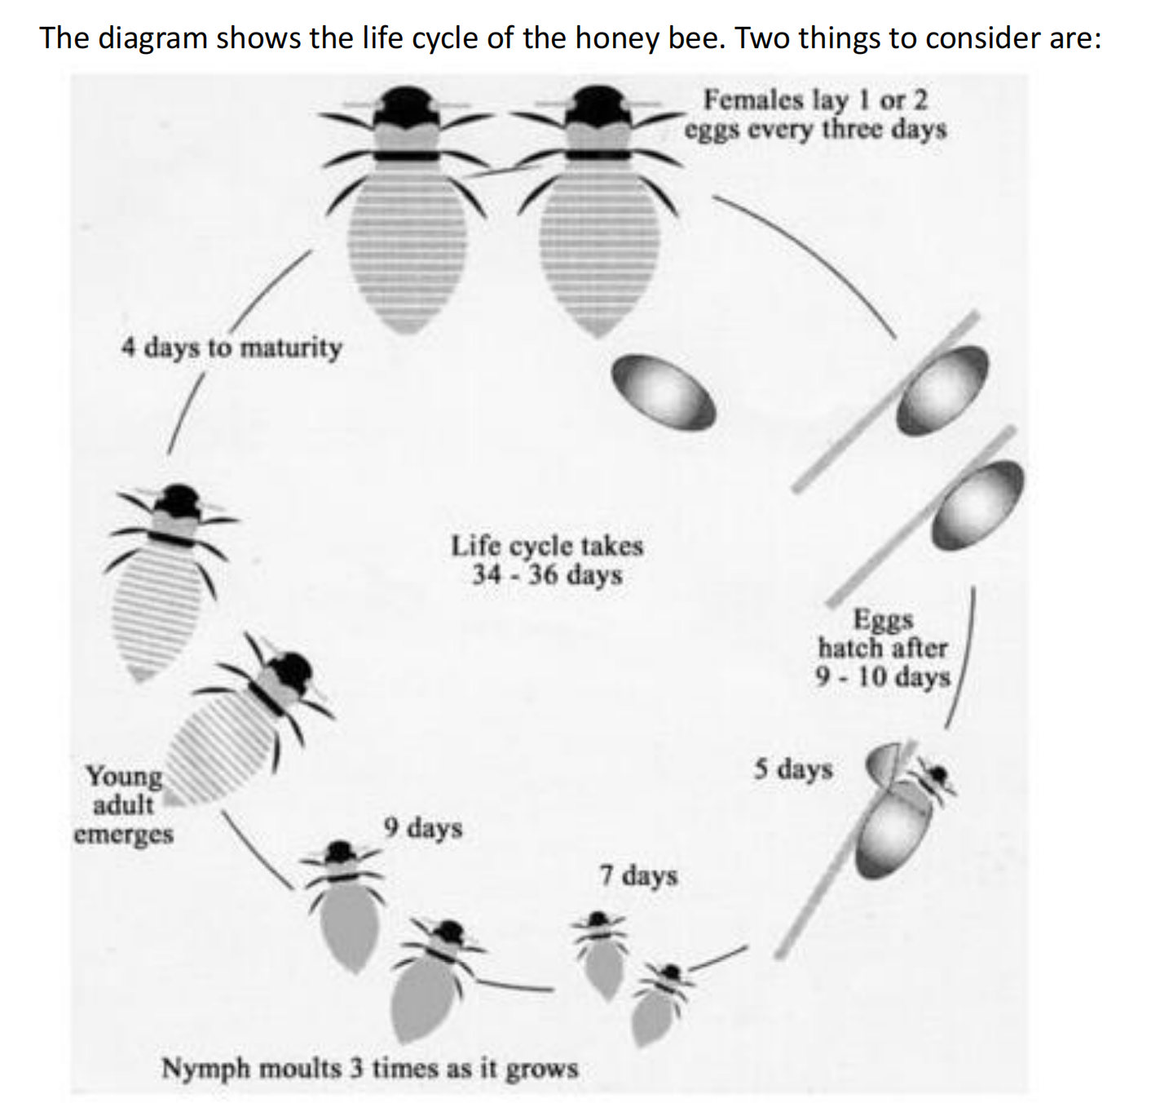
5.生物类PRACTICE
The life cycle of the honey bee begins when the female adult lays an egg; the female typically lays one or two eggs every 3 days. Between 9 and 10 days later, .
During the third stage of the life cycle, . This moulting first takes place 5 days after the egg hatches, then 7 days later, and again another 9 days later. After a total of 30 to 31 days from the start of the cycle, , and in the space of only 4 days .
（Simon, band 9)
2020真题

Slide 29
5.生物类PRACTICE
The life cycle of the honey bee begins when the female adult lays an egg; the female typically lays one or two eggs every 3 days. Between 9 and 10 days later, each egg hatches and the immature insect, or nymph, appears.
During the third stage of the life cycle, the nymph grows in size and sheds its skin three times. This moulting first takes place 5 days after the egg hatches, then 7 days later, and again another 9 days later. After a total of 30 to 31 days from the start of the cycle, the young adult honey bee emerges from its final moulting stage, and in the space of only 4 days it reaches full maturity.
（Simon, band 9)
2020

Slide 30
目录
1.流程图特点及首段写作
2.流程图词汇及衔接手段
3.流程图（工序圈）范文分析及主体段练习
4.流程图（生长图）范文分析及主体段练习
5.流程图总结段写作
6.课后作业 流程图写作练习

Slide 31
5. 概述段
过程/装置复杂or简单（一般复杂）（+具体场所）
Overall, the production of instant noodles is complex,
with few types of raw materials manufactured on a production line.
参考句式：
Overall, the production of _______ is complex, with few/several types of raw materials manufactured on/in some place.

Slide 32
5. 概述段
过程/装置复杂or简单（一般复杂）（+具体场所）
Overall, the electricity production in geothermal power station is complex, with processing steps undergoing underground and on the ground.
参考句式：
Overall, the production of _______ is complex, with few/several types of raw materials manufactured on/in some place.

Slide 33
5.概述段PRACTICE
「overview model」Overall, the production of _______ is _____ , with few/several types of __________ manufactured on/in _____ .

Slide 34
（机经）
5.概述段PRACTICE
Overall, the production of bricks is complex, with few types of constructed materials manufactured on a production line.

Slide 35
目录
1.流程图特点及首段写作
2.流程图词汇及衔接手段
3.流程图（工序圈）范文分析及主体段练习
4.流程图（生长图）范文分析及主体段练习
5.流程图总结段写作
6.课后作业流程图写作练习

Slide 36
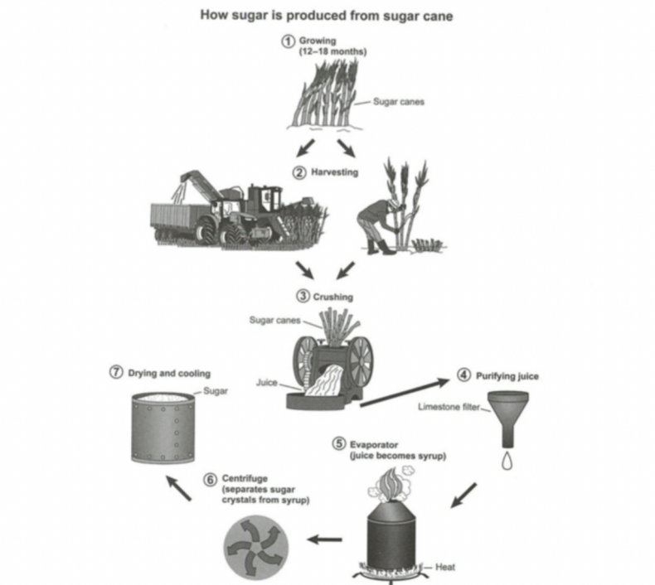
7. Homework
The diagram below shows the manufacturing process for making sugar from sugar cane.
（C16T2W1）

Slide 37
PRACTICE MAKES PERFECT !
THANK YOU.

